Slide 1
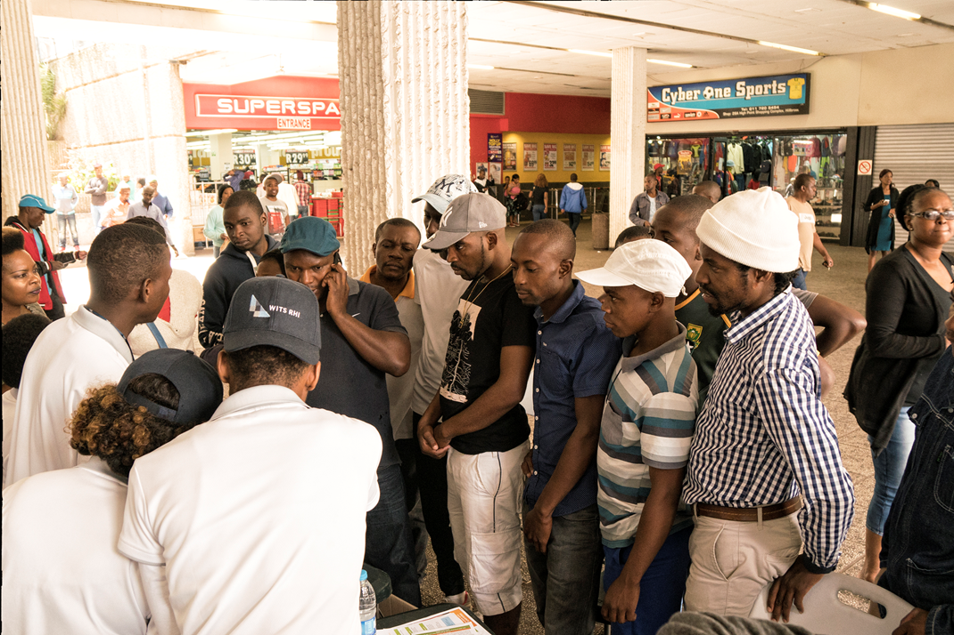
Unitaid/WHO/PSI Satellite on Reaching Men

Slide 2
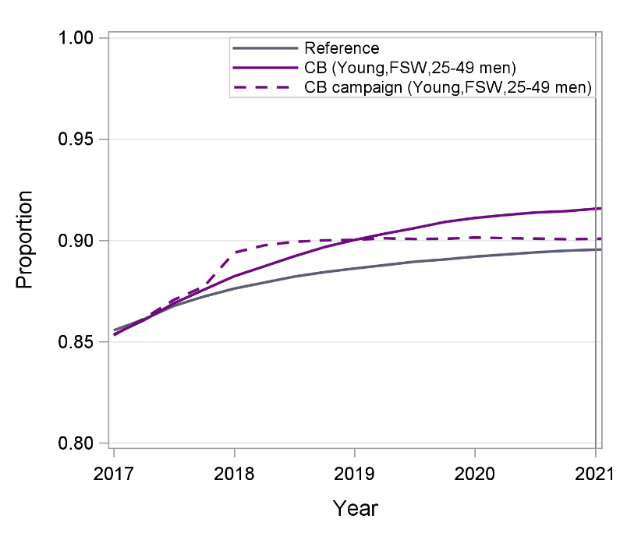
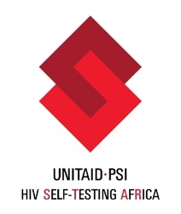
Can we achieve the 1st 90 without HIVST In Zimbabwe?
With the introduction of community-based HIVST in young people, FSW and adult men, it will be possible to achieve the first 90 by 2019 !
Notes:
The finding is similar to those found by Monisha Sharma that foud that Home-Based HIV Testing and Education (HOPE) for Pregnant Women and Their Male Partners in Nyanza Province, Kenya.
They found that assuming a cost of $31–37 and $14–16 USD per couple tested with program and task-shifting costs, respectively. At 60% coverage of male partners, HOPE was projected to avert 6987 HIV infections and 2603 deaths in Nyanza province over 10 years with an incremental cost-effectiveness ratio (ICER) of $886 and $615 respectively

Slide 3
Unitaid/WHO/PSI Satellite on Reaching Men

